Slide 1

GPS DETECTION
NAME: ABHINANDANA N HOWLE
SRN:PES2UG22EC005
NAME:KEERTHIKA
SRN:PES2UG22EC066
NAME:SANJAY
SRN:PES2UG22EC116
Notes:
GPS DETECTION

Slide 2
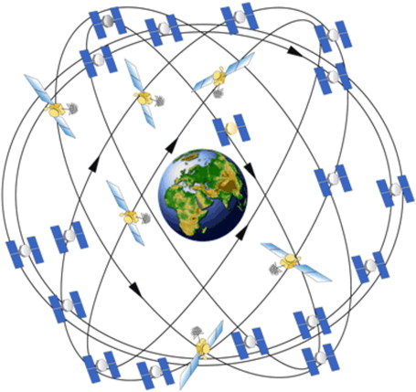
WHAT IS GPS?
GPS (Global Positioning System) is a satellite-based navigation system that provides location, velocity, and time information to users anywhere on Earth.
GPS is used in:
1)Satellites
2)Location tracking
3)Mapping
4)Time synchronization etc…

Slide 3
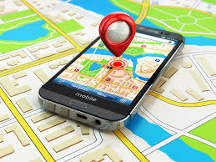
Tools used in GPS detection:
1.VirtualRadar Setup
2. GNS 3
3.also detecting GPS in open field using SDR antenna

Slide 4
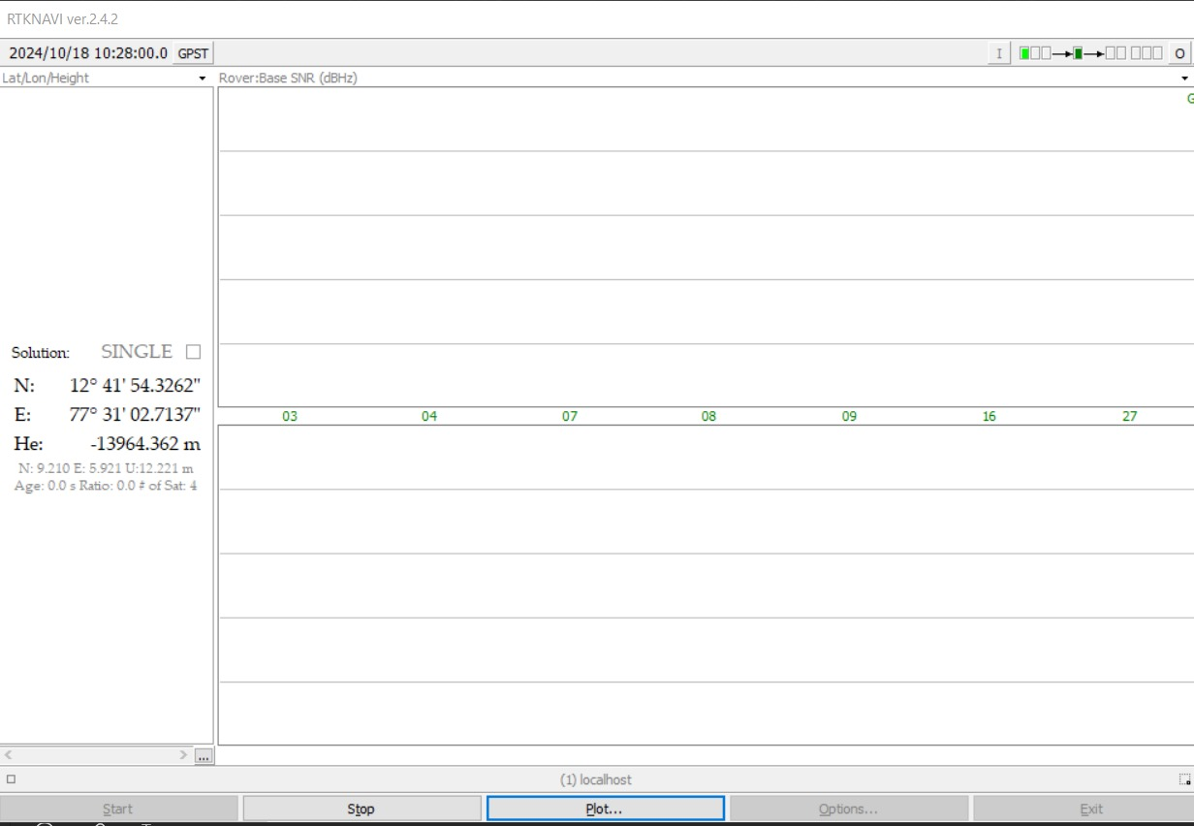

Slide 5
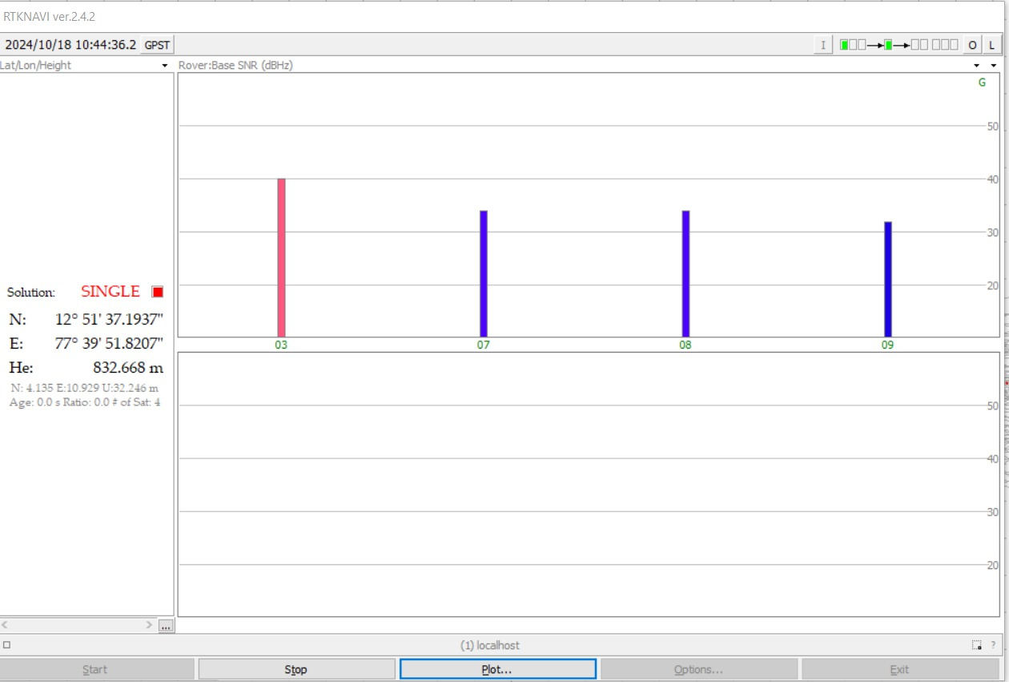

Slide 6
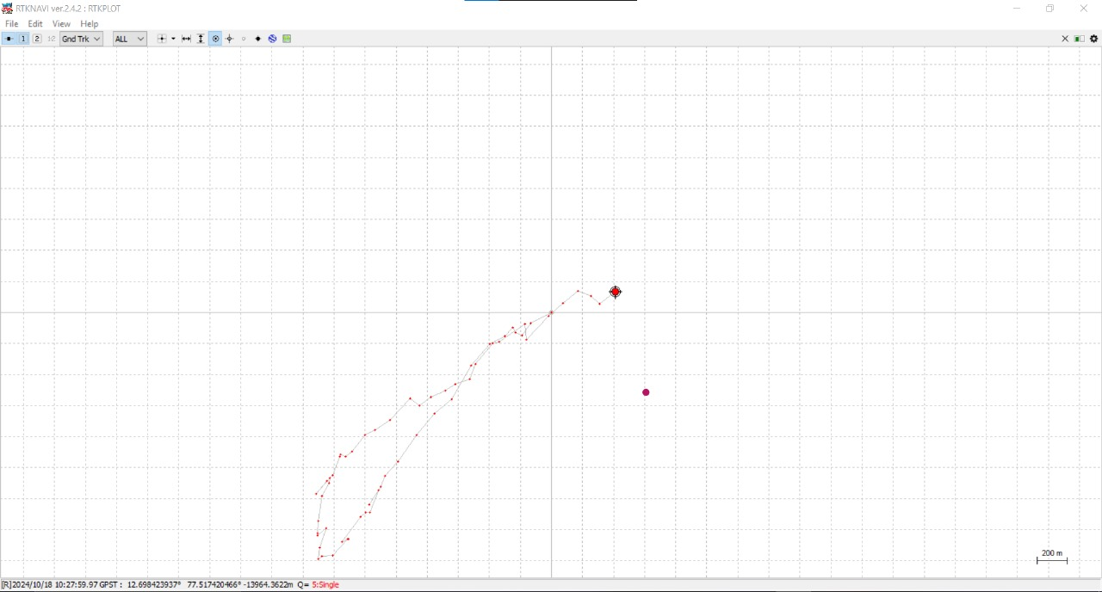

Slide 7
